Slide 1
ALPHA-NUMERIC
RECOGNITION SYSTEM
Presented by
AAYUSH VERMA (18115003)
AKASH (18115011)
ARYAN RAJ (18115022)
TANMAY SARKAR (18115113)
Supervised by
DR. SOHOM CHAKRABARTY

Slide 2
Introduction
As Deep Learning field is growing everyday, so is its application by leaps and bounds. One of the area of this is of Computer Vision.
Motivated by this, we have taken up this project of creating an alpha-numeric recognition system.
Our project gives an insight to how effective sequential convolutional networks are in this domain.
Various other challenges that is faced while creating such a model is also reported and the ways to overcome them is also addressed.

Slide 3
Objective
The objective of our project can be summarized in following few points:
Building a recognition system (multi-class classification) for English alphabets and digits.
Creating the dataset and filtering it.
Using techniques like in-place data augmentation to enhance the diversity of the dataset.
Finding out the optimal hyperparameters and parameters for the model.
Deploying the model in the form of a web application.

Slide 4
Data Collection
We created our dataset ourselves. For this, we first used the data crawling method to collect raw data from the chrome web browser.
We used a Web scraping tool named ParseHub.
After we were done with data crawling, we manually filtered some of the images.

Slide 5
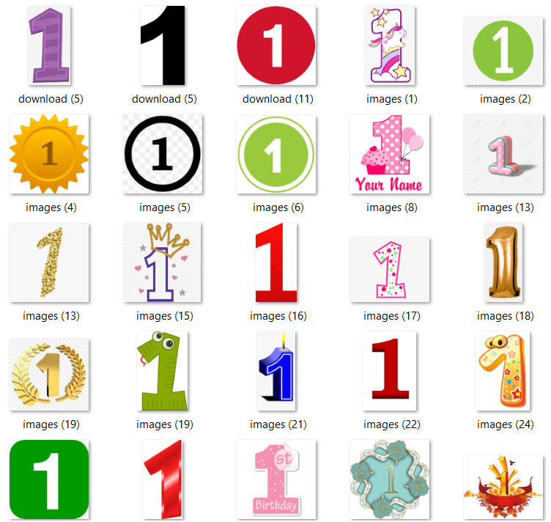
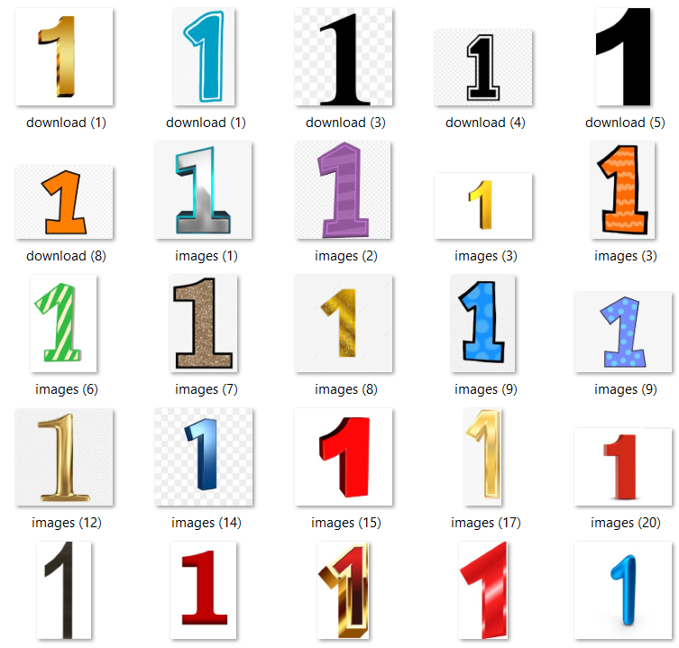
Data Collection
Raw Data
Clean Data

Slide 6
Data Pre-processing
After we had created the dataset for our use, we moved on to pre-processing our data.
We have used Keras Image Data Generator which uses in-place data augmentation technique.
It creates randomized versions of our input images thereby helping the model to learn about more general features of numerals and alphabets.

Slide 7
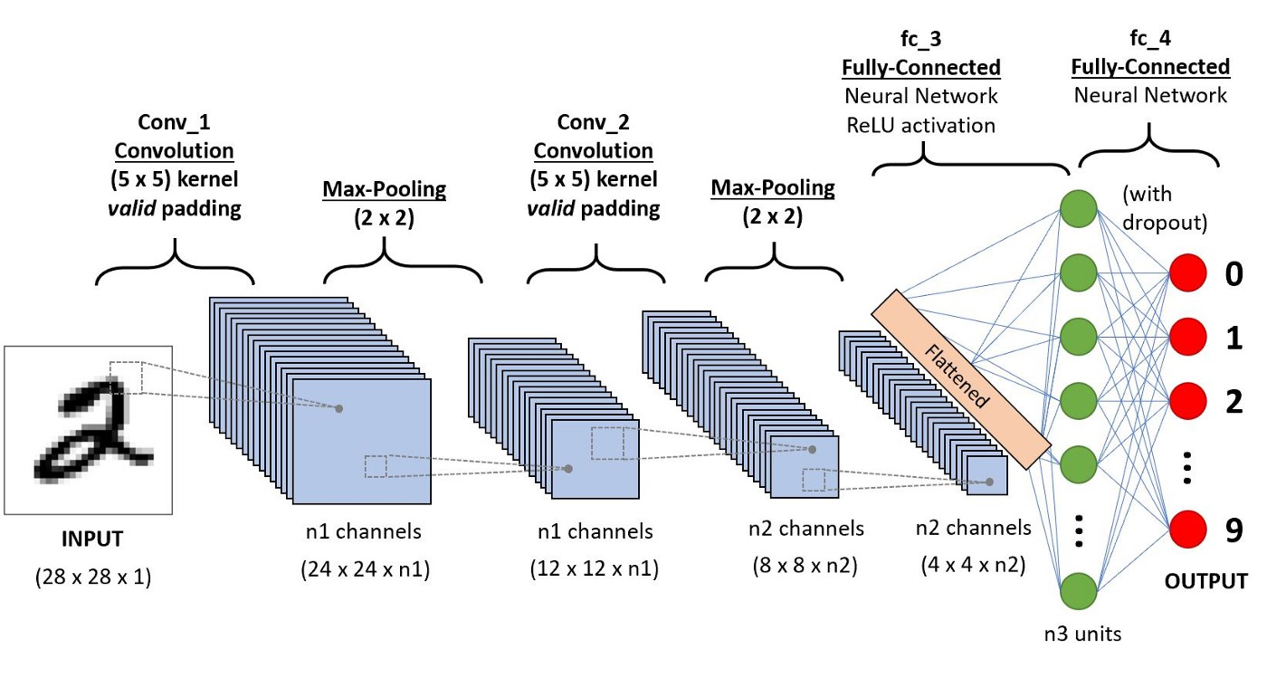
General CNN Architecture for Classification

Slide 8
For extracting features from the images, we used 2-3 convolutional layers. The output of each convolutional layer is passed through relu activation and then passed as input to pooling layer.
Now, we are going to flatten the final output and feed it to a regular Neural Network which consists of fully connected layers.
We have kept 2 hidden dense layers. And, dropout regularization technique was applied after each hidden dense layer.
Final output layer uses Softmax activation function for classification.

Slide 9
Training History
Training was done by tuning mainly the following hyperparameters:
Various features of image using data augmentation
Batch size
Number of hidden/dense layers and convolutional layers
Input size of images
Dropout
Epochs
Model behaviour was tracked using Weights and Biases which is a tool for visualizing and tracking hyperparameters and metrics.
Best models were saved regularly in case of improvement and used for predicting images in the web app.

Slide 10
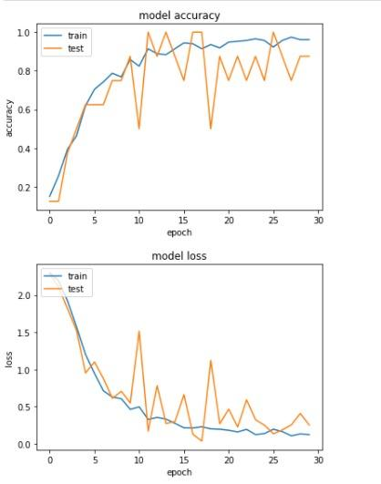
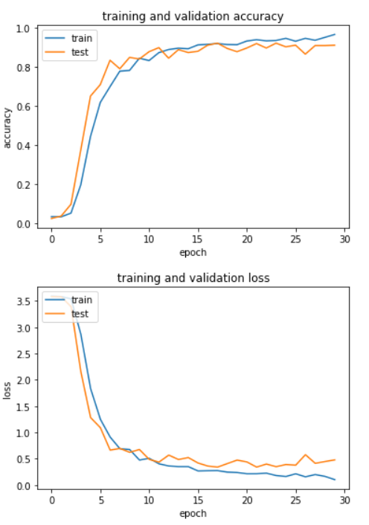
Learning Curves

Slide 11
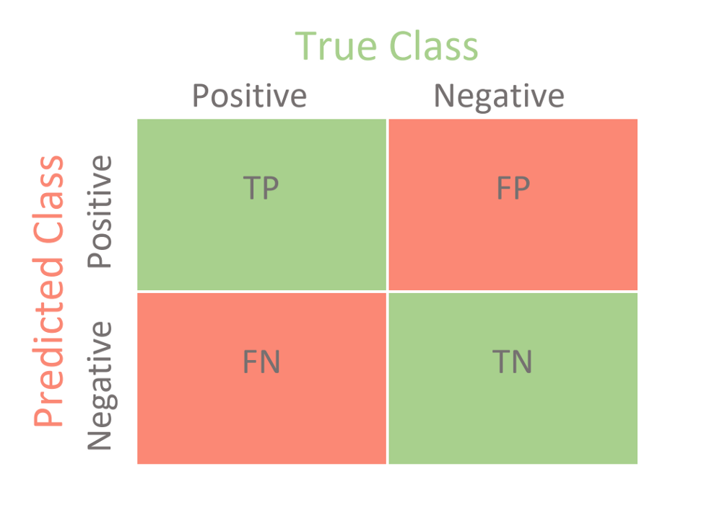
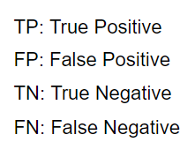
Classification Report
Confusion matrix: It is a table in the form of a matrix that helps us to describe the performance of a classifier on a set of test data, where true values are known to us.
With the help of TP, TN, FN, and FP, other performance metrics can be calculated:
Precision: Precision is basically the percentage of true positive values out of all the predicted positive value.
Precision = TP/(TP+FP)

Slide 12
Recall: Recall is the percentage of the true positive values out of the real positive values.
Recall=TP/(TP+FN)
F1 score: This metric is the harmonic average of the precision and recall value. It’s value lies between 0 and 1.
F1 Score=2/{(1/Precision)+(1/Recall)}
Accuracy: Accuracy is the percentage of correct predictions.
Macro average: Macro average is the usual average.
Weighted average: In case of weighted average, we assign certain weights to the values we have in hand based on certain properties or criteria and then take the average.

Slide 13
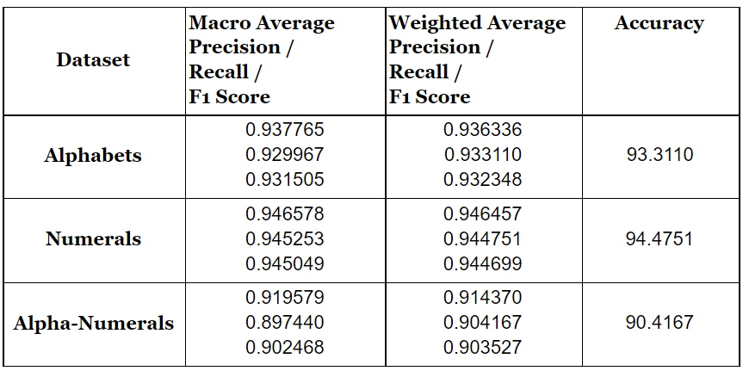
Results
We experimented with various parameters and hyperparameters to find the best model for our dataset.

Slide 14
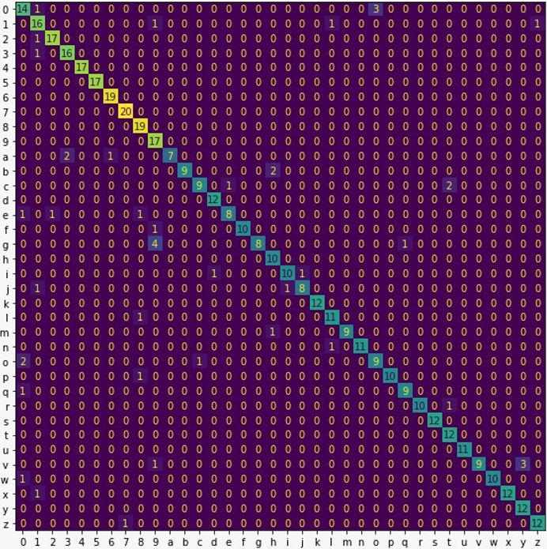
Confusion Matrix

Slide 15
Observations
On the alphabet dataset, our model gets confused between a certain set of letters like (c,e), (u,v), and (b,h).
On the combined dataset, our model gets confused between (o,0), (9,g), (1,l).
On the bright side, our model did classify some similar looking classes like (6,b), (5,s), (2,z) correctly.

Slide 16

Web App Demonstration

Slide 17
Conclusion
Even though, satisfactory results were obtained, the model isn’t robust due the size of the dataset and limitations in predicting many general images.
So, first focus should be on gathering more generic and quality data followed by experimenting with various augmentation.
With further experiments with model architectures and parameters, a generic model can be developed for character recognition which can predict standard as well as handwritten texts.
Extending this subtask to multi-label classification which is a slightly harder variant of this problem.
Developing a recognition system through web app is one of the ways of using reliable models to solve real-life problems.

Slide 18
References
Sakshi Butala, S 2020, Building and Deploying an Alphabet Recognition System,accessed 14 August 2021,
<https://towardsdatascience.com/building-and-deploying-an-alphabet-recognition-system-7ab59654c676>
Aniruddha Bhandari, A 2020, Image Augmentation on the fly using Keras
ImageDataGenerator!, accessed 12 August 2021,
<https://www.analyticsvidhya.com/blog/2020/08/image-augmentation-on-the-fly-using-keras-imagedatagenerator/>
Sumit Saha, S 2018, A Comprehensive Guide to Convolutional Neural Networks —the ELI5 way, accessed 2 August 2021,
<https://towardsdatascience.com/a-comprehensive-guide-to-convolutional-neural-networks-the-eli5-way-3bd2b1164a53>
Bora, Mayur Bhargab, et al. "Handwritten character recognition from images using cnn-ecoc." Procedia Computer Science 167 (2020): 2403-2409.
Srivastava, N., Hinton, G., Krizhevsky, A., Sutskever, I., & Salakhutdinov, R. (2014). Dropout: a simple way to prevent neural networks from overfitting. The journal of machine learning research, 15(1), 1929-1958.

Slide 19
THANK YOU

